Slide 1
Fauvism
This resource is included in TATA’s COVID19 visual art resources collection with appreciation and permission from its creator, Kate Camm, from Elizabeth College , Tasmania. TATA does not have ownership of the IP (Intellectual Property) contained within the resources shared on this website. TATA acknowledges the generosity of sharing practice that underpins this collaborative resource sharing space, and ask that any on-sharing of resources acknowledge the originating IP of the Arts/Education professional/s who have contributed this resource, as well as any third party content acknowledged therein
April 10th, 2020 Courtesy of Kate Camm, Elizabeth College, https://tata.org.au/

Slide 2
What is Fauvism?
Fauvism is a French word meaning Wild Beasts
The movements started in France in 1899 until around 1908
This movement is all about expressing emotion through colour
The Fauves wanted to use colour not as a part of the painting but as the painting- as the most important feature
This was very radical for the time
This movement is not concerned with perfection or realness. The Fauves did not care about reflecting the natural world
The Fauves simplified forms and saturated colours and were greatly concerned with creating harmony in their work

Slide 3
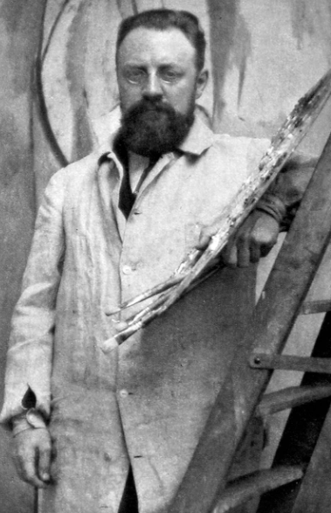
Who was involved?
Henri Matisse- Born in 1869, France, to a Bohemian family of textile weavers. Seeing the many bright and varied textiles sparked his love of colour
"From the moment I held the box of colors in my hands, I knew this was my life. I threw myself into it like a beast that plunges toward the thing it loves.”
Matisse was famous for using pure unmodulated colour to create form in his work as opposed to shading

Slide 4
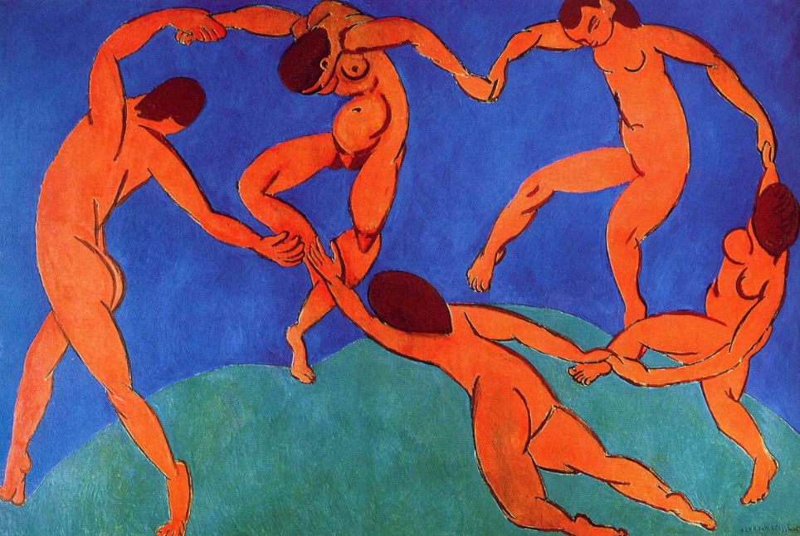
La danse (I) (1909) by Henri Matisse

Slide 5
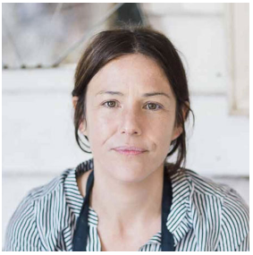
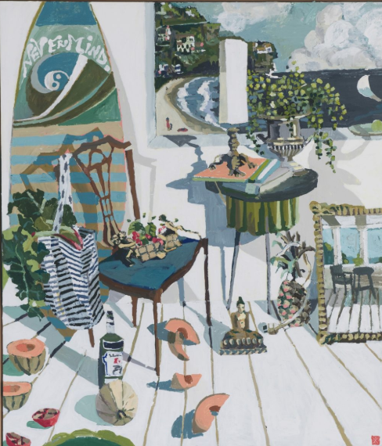
How does Fauvism exist now?
Zoe Young
Excerpt from “Scenes From a Cookbook”
Illuka Road, 2018

Slide 6
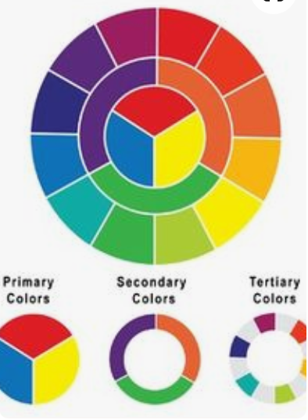
Colour Mixing
Colour wheel: Primary, Secondary & Tertiary

Slide 7
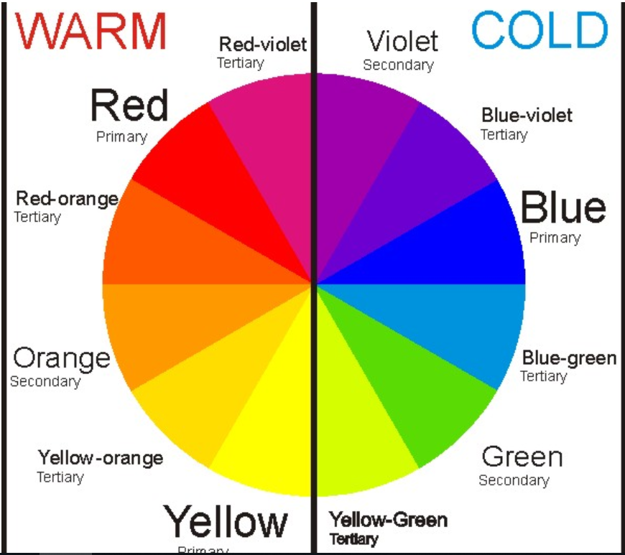
Warm and Cool

Slide 8
Tints and Shades
Tints are when you add white to a colour
Tones are when you add grey to a colour
Shades are when you add black to a colour

Slide 9
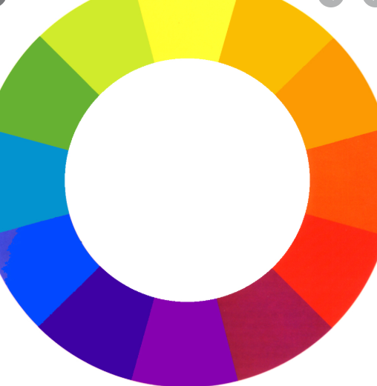
Harmonious Colours & Complimentary Colours
Harmonious colours sit next to one another on the colour wheel
Complimentary colours sit opposite each other on the colour wheel

