Slide 1
Grade 8 Art Draw me a song TEXT in ART
This resource is included in TATA’s COVID19 visual art resources collection with appreciation and permission from its creator, Caz Saunders from Riverside High School, Tasmania. TATA does not have ownership of the IP (Intellectual Property) contained within the resources shared on this website. TATA acknowledges the generosity of sharing practice that underpins this collaborative resource sharing space, and ask that any on-sharing of resources acknowledge the originating IP of the Arts/Education professional/s who have contributed this resource, as well as any third party content acknowledged therein

Slide 2
Learning Intentions
We are learning to:
create an artwork that uses text as the main design feature
apply the principle of design, emphasis, to create a focal point
We will be successful when we are able to:
Practise a variety of text styles in our journals using pencil and/or fineliner
Plan some artwork that uses text as a main element and considers emphasis/focal point
Complete a drawing or mixed media artwork where text is used as a design element to express a song title, some song lyrics or lines from a poem

Slide 3
Although text is all around us, on magazine covers, cereal boxes, street signs and posters, we rarely think of it as an element of art.
Yet each letter can have shape and colour and, if the words were void of meaning, would be ideal for creating abstract work.
The addition of meaning, such as linking your text to the lyrics of a song, adds another level of depth to using text as an element that can not be created by shape and colour alone.
Many contemporary artists utilize text in their art, pushing past the concept that text is only meant to be read.

Slide 4
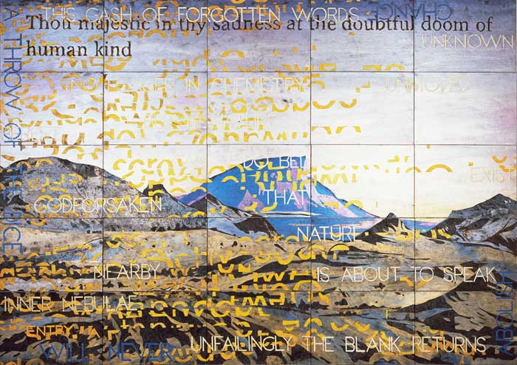
Imants Tillers

Slide 5
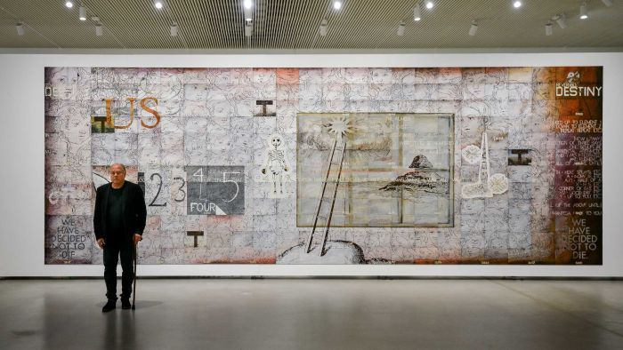
Imants Tillers

Slide 6
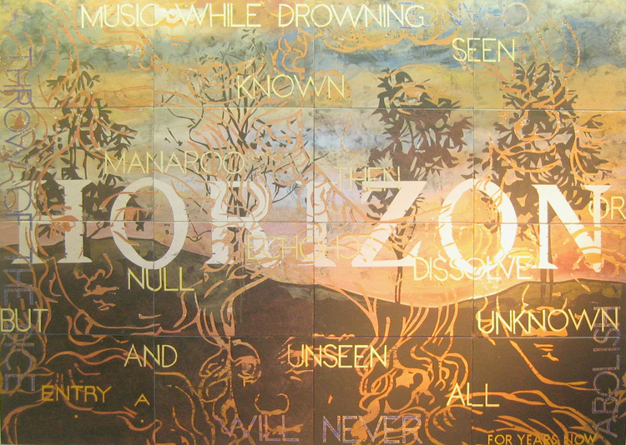
Imants Tillers

Slide 7
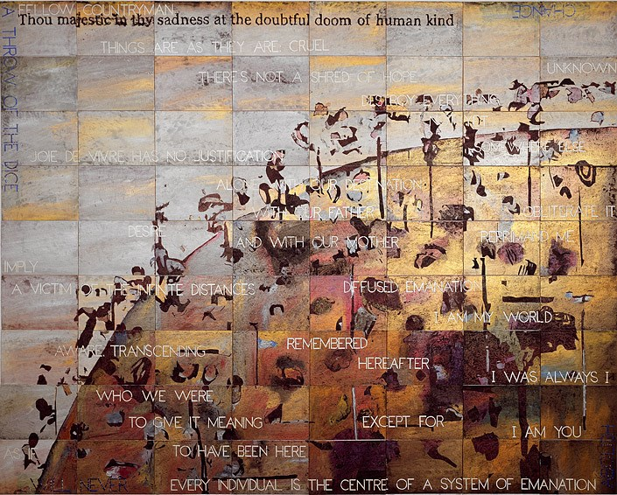

Slide 8
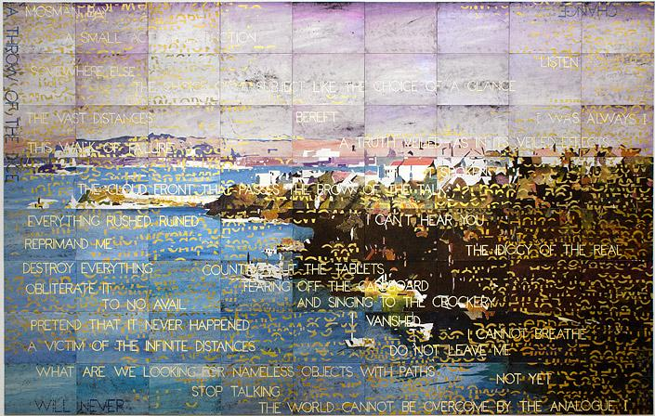

Slide 9
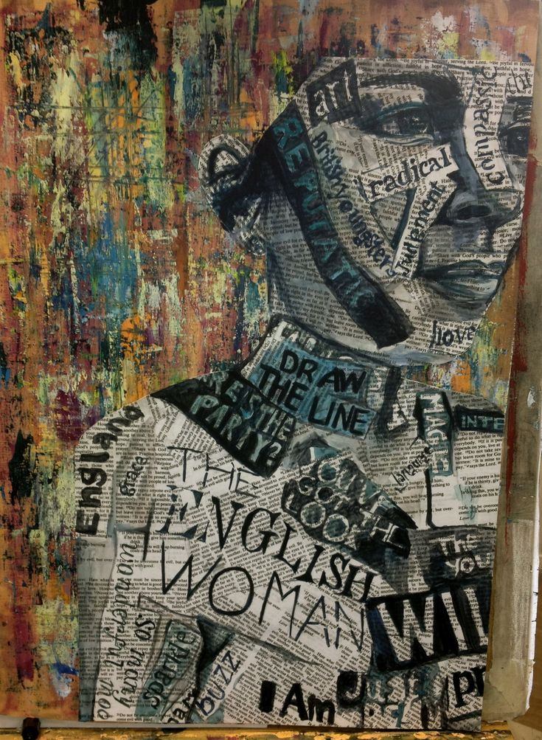

Slide 10
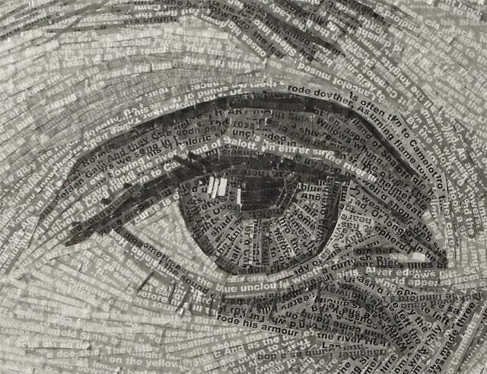

Slide 11
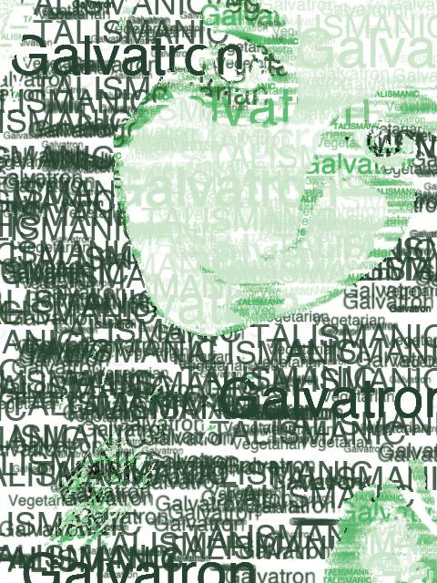

Slide 12
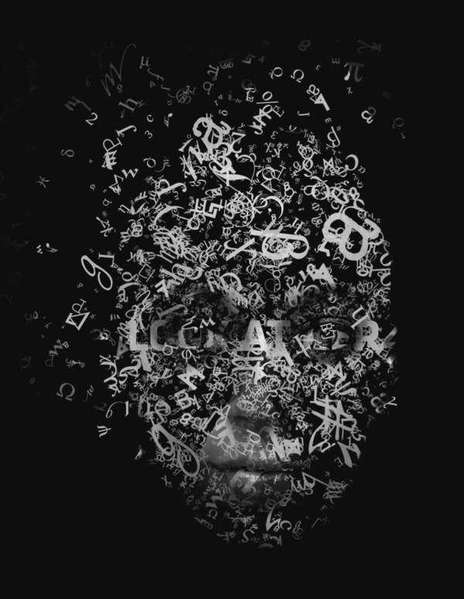

Slide 13
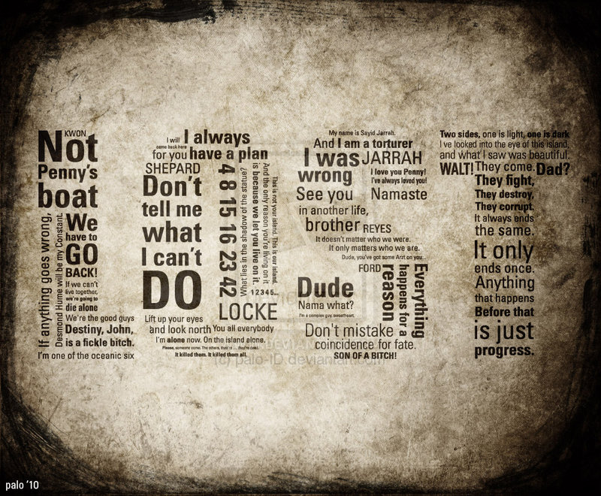

Slide 15
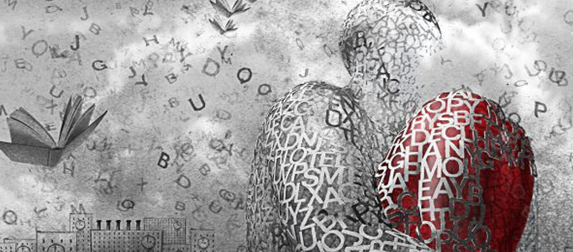

Slide 17
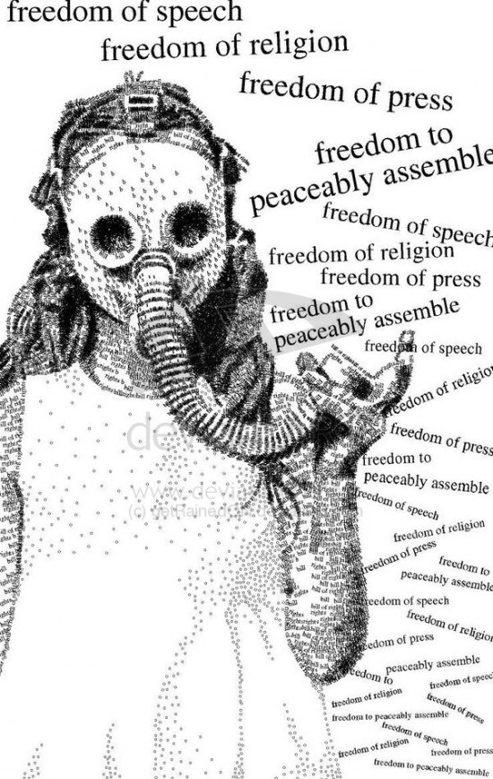

Slide 19
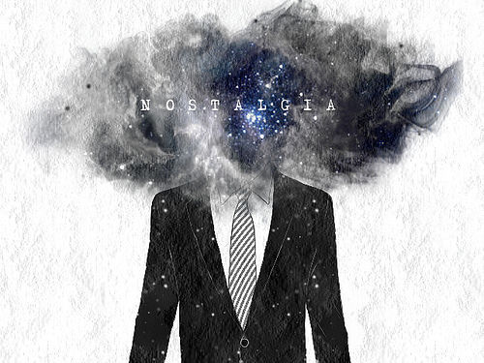

Slide 20
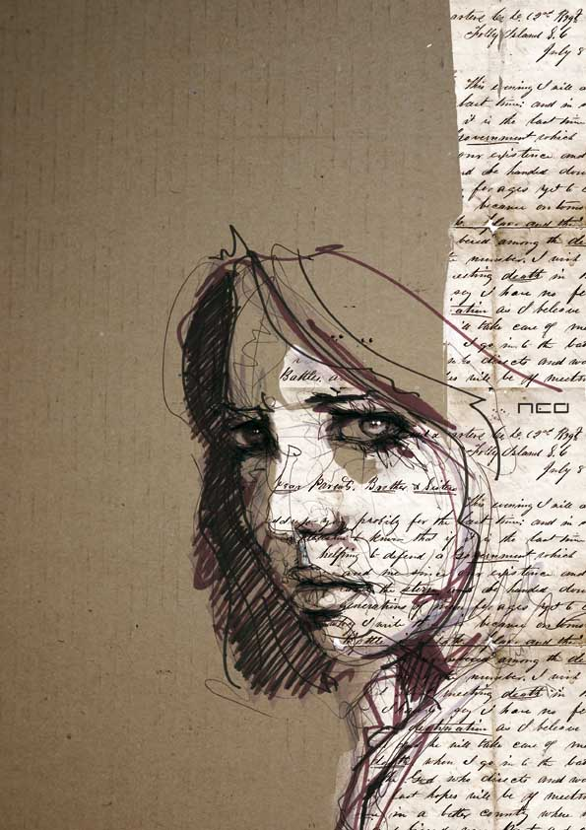

Slide 21
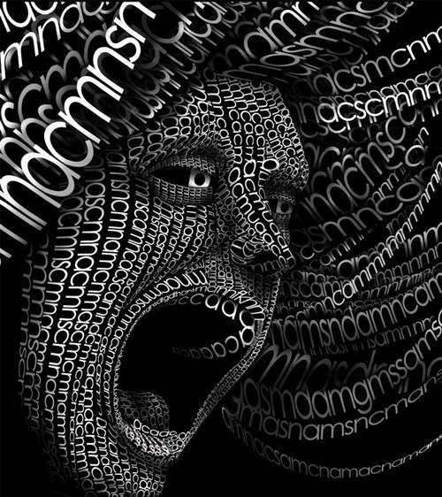

Slide 22
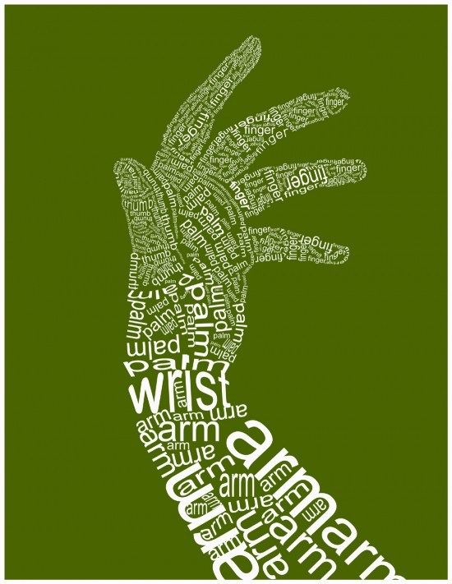
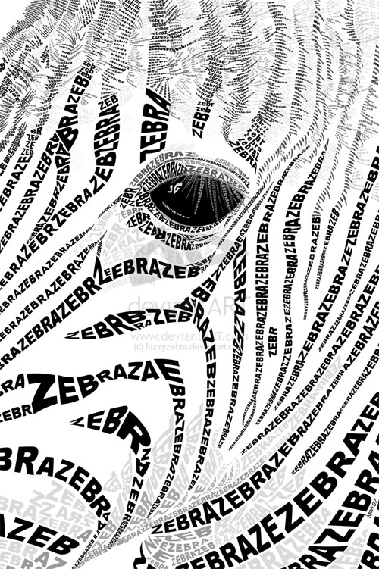

Slide 23
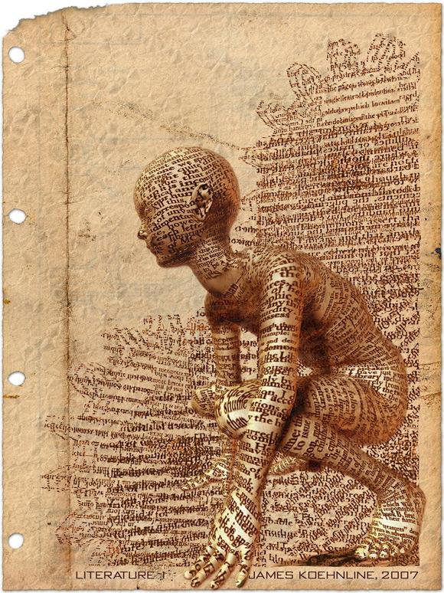

Slide 24
