Slide 1
Creating Your Own Landscape
This resource is included in TATA’s COVID19 visual art resources collection with appreciation and permission from its creator, Kate Camm from Elizabeth College, Tasmania. TATA does not have ownership of the IP (Intellectual Property) contained within the resources shared on this website. TATA acknowledges the generosity of sharing practice that underpins this collaborative resource sharing space, and ask that any on-sharing of resources acknowledge the originating IP of the Arts/Education professional/s who have contributed this resource, as well as any third party content acknowledged therein
April 10th, 2020 Courtesy of Kate Camm, Elizabeth College, https://tata.org.au/

Slide 2
A monochrome painting is a work of art that consists of a single color. In fact, the word monochrome literally means ''one color.'' It's a different approach to art, but one that's used more widely than you might think.
Technique
So, how do you create a painting if you're only using one color? The key to this is remembering that blue and green are different colors, but dark blue and light blue are not; these are just values of the same color. From the base color, a hue can be tinted by adding white, making it lighter. Theoretically, you can continue doing this until achieving almost pure white. At the same time, a color can be shaded by adding black. Thus, artists can paint an entire piece consisting of lines, shapes, and figures in various shades and tints that are, technically, only one color.

Slide 3
Thumbnail Sketches — Shorthand Drawing for Artists
Thumbnail Sketches are Shorthand Notes for Artists: Thumbnail sketches are drawing quick, abbreviated drawings. Usually, they are done very rapidly and with no corrections - you can use any medium, though pen or pencil is the most common. Thumbnails sketches are usually very small, often only an inch or two high.
Thumbnails are Memory Aids and Planning Tools: Thumbnail sketches can serve as a memory aid to help you remember important features of a subject, when making notes for a painting or drawing. They are also useful when visiting a gallery, to help you remember important pieces. Ofen artists use thumbnail sketches to plan pictures. You can quickly experiment with format and composition, placing just the major features - such as the horizon and any large objects, and indicating movement and balance.
How to Draw a Thumbnail Sketch: Imagine your subject or picture stripped of all details, through squinted eyes, or in poor light. All you see are big rough shapes and some lines. Thats all you need for a thumbnail. First, sketch a rough box, smaller but in the same proportions as the finished picture might be. Then sketch in the horizon line, hills, or any major verticals or horizontals. The outline any key shapes, and quickly hatch in any strong dark areas. There are no right or wrong ways - that's my approach, and it might work for you.

Slide 4
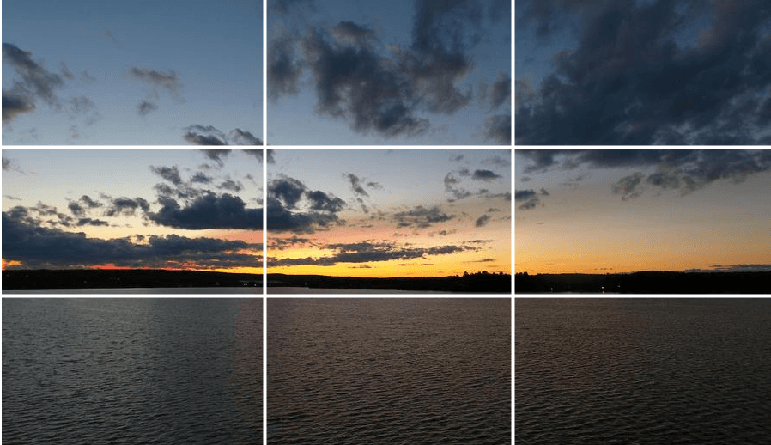
Use your viewfinder to help you to compose your image.
The idea is that you place the more interesting parts of your image at the sections where the lines intersect

Slide 5
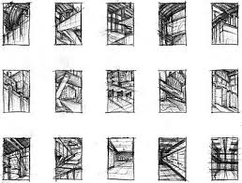

Slide 6
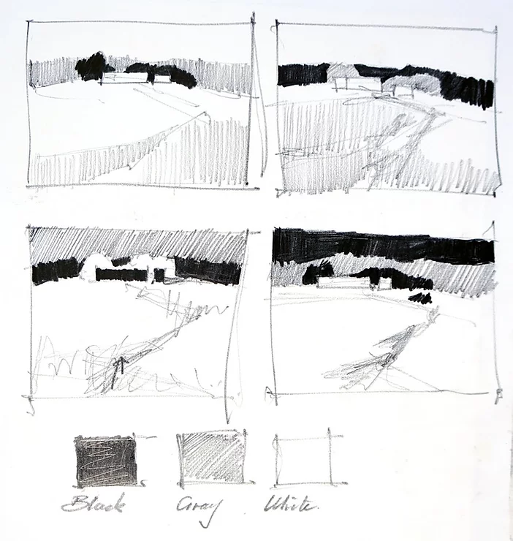

Slide 7
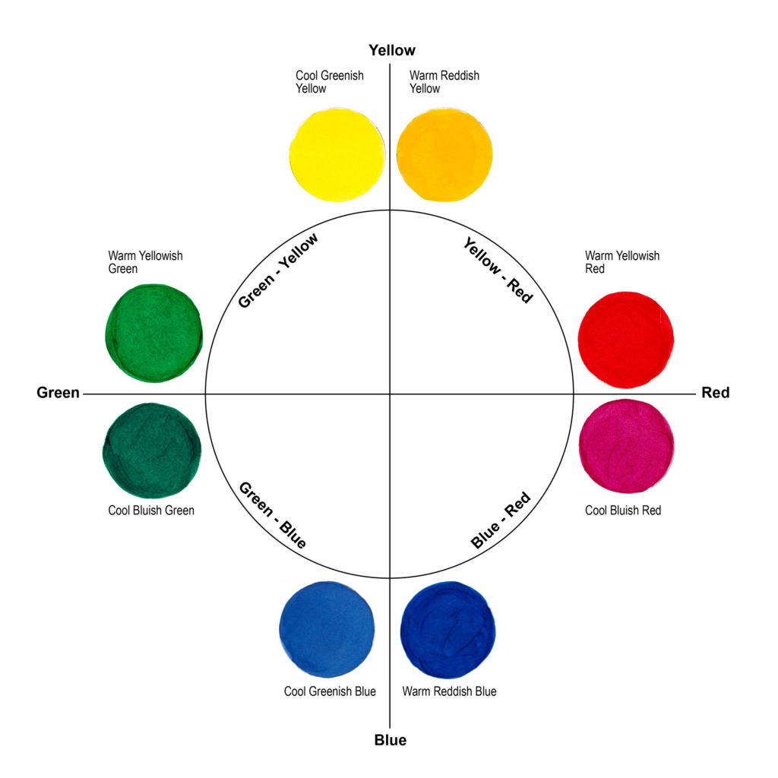

Slide 8
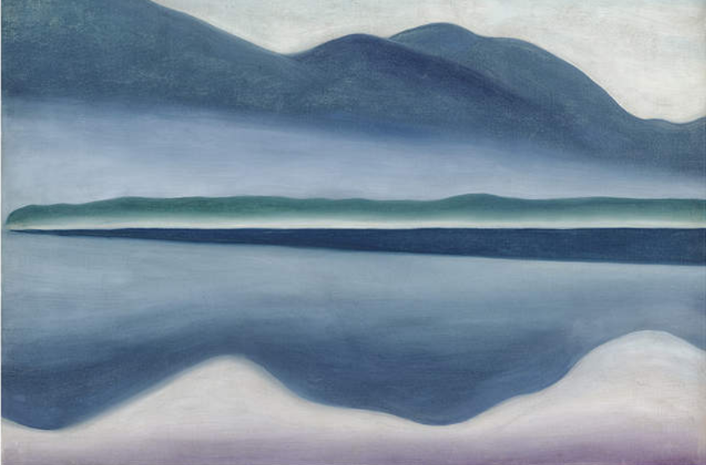
Georgia O’Keeffe, American (1887—1986). Lake George, 1922. Oil on canvas
https://www.famsf.org/blog/weekends-georgia

Slide 9
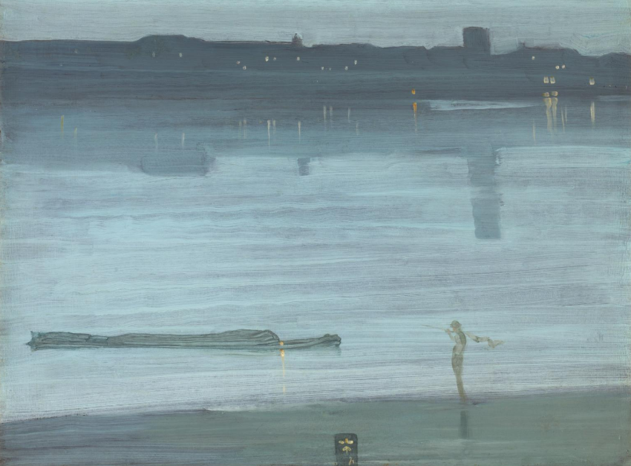
James Abbott McNeill Whistler
Nocturne: Blue and Silver - Chelsea
1871
https://www.tate.org.uk/art/artworks/whistler-nocturne-blue-and-silver-chelsea-t01571

Slide 10
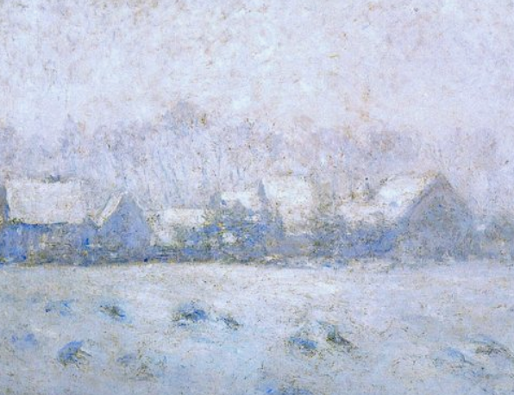
Claude Monet: Effet de neige à Giverny (1892-93)
https://www.metmuseum.org/art/collection/search/437123

Slide 11
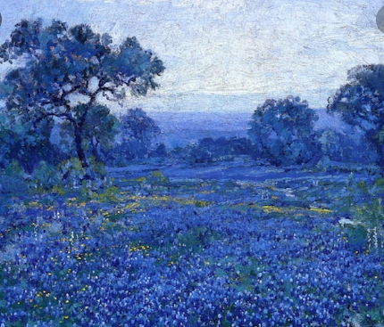
Julian Onderdonk
https://mymodernmet.com/julian-onderdonk-impressionist-paintings-bluebonnets/

